Slide 1
CS3391 Object Oriented Programming
Dr.D.Sivaganesan, Professor, PSGiTech / CSE

Slide 2
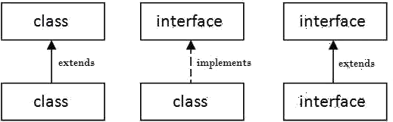
INTERFACE IN JAVA
An interface in java is a blueprint of a class.
It has static constants –final and abstract methods.
The interface in java is a mechanism to achieve abstraction and multiple
inheritance.
Interface is declared by using interface keyword.
It provides total abstraction; means all the methods in interface are declared
with empty body and are public and all fields are public, static and final by
default.
A class that implement interface must implement all the methods declared
in the interface.
Syntax:
interface <interface_name>
{
// declare constant fields
// declare methods that abstract by default.
}
2

Slide 3
interface printable
{
Example :
int v=25; // data or field - final
void print(); // abstract method
}
class exinterface implements printable // accessing interface
{
public void print()
{
v=v+10;
System.out.println("Interface method Hello "+v);
}
public static void main(String args[])
{
exinterface obj = new exinterface();
obj.print();
}
}
CS8392 Object Oriented Programming
Dr.D.Sivaganesan and N.Arvindhraj PSGiTech / CSE
3

Slide 4
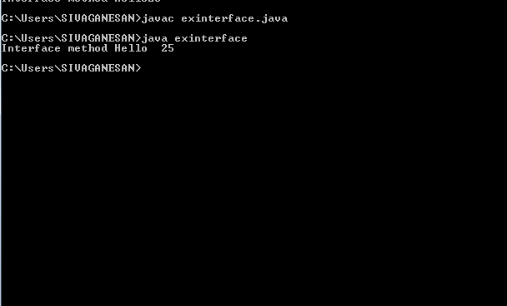
CS8392 Object Oriented Programming
Dr.D.Sivaganesan and N.Aravindhraj PSGiTech / CSE
4

Slide 5
Multiple Inheritance
interface show // base interface
{
void draw(); }
class A // base class
{
public void display() { System.out.println("base class");} }
class C extends A implements show // more than one base
{
public void draw()
{
System.out.println("Multiple inheritance");}}
class mulinheritance
{
public static void main(String args[]){
C d=new C(); d.display(); d.draw(); }}
CS8392 Object Oriented Programming
Dr.D.Sivaganesan and N.Arvindhraj PSGiTech / CSE
5

Slide 6
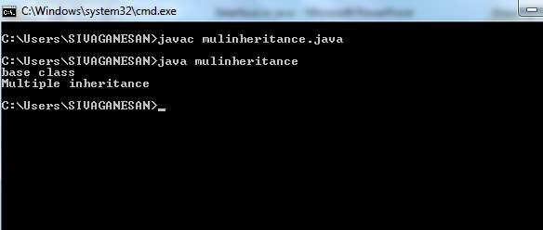
CS8392 Object Oriented Programming
Dr.D.Sivaganesan and N.Aravindhraj PSGiTech / CSE
6

Slide 7
interface show1
{
void draw(); }
interface show2
{
void display(); }
class C implements show1,show2 // multiple base interface
{
public void display()
{
System.out.println("Interface show1"); }
public void draw()
{ System.out.println("Interface show2");
}}
class mulinheritance2
{
public static void main(String args[]){
C d=new C(); d.display();
d.draw();
} }
CS8392 Object Oriented Programming
Dr.D.Sivaganesan and N.Arvaindhraj PSGiTech / CSE
7

Slide 8
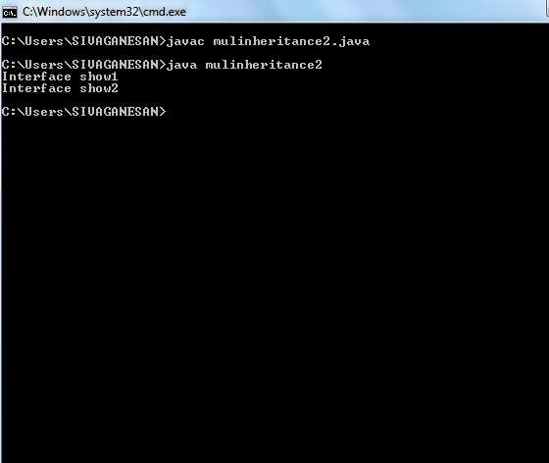
CS8392 Object Oriented Programming
Dr.D.Sivaganesan and N.Aravindhraj PSGiTech / CSE
8

Slide 9
Extending interface
Like extending class inetrface can also extends by another interface
interface Printable{
void print();
}
interface Showable extends Printable{
void show();
}
class interextend implements Showable
{
public void print()
{System.out.println("Hello");}
public void show()
{System.out.println("Welcome");}
public static void main(String args[])
{
interextend obj = new interextend();
obj.print();
obj.show(); }}
CS8392 Object Oriented Programming
Dr.D.Sivaganesan and N.Aravindhraj PSGiTech / CSE
9

Slide 10
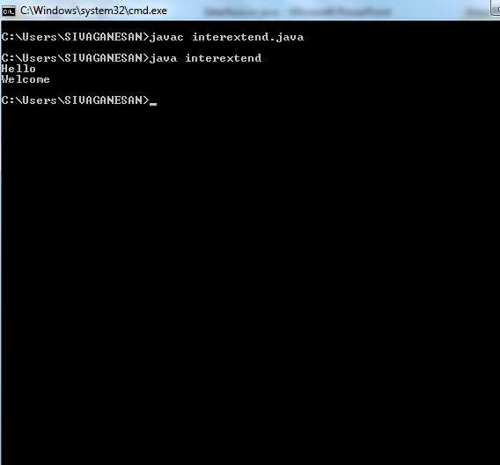
CS8392 Object Oriented Programming
Dr.D.Sivaganesan and N.Arvaindhraj PSGiTech / CSE
10

Slide 11
Nested Interface in Java
An interface can have another interface i.e. known as nested interface.
interface printable
{
void print();
interface MessagePrintable
{
void msg();
}
}
CS8392 Object Oriented Programming
Dr.D.Sivaganesan and N.Aravindhraj PSGiTech / CSE
11

Slide 12
interface Printable
{
void print();
interface Showable
{ void show();}
}
class nestedinterface implements Printable
{
public void print()
{System.out.println("Hello");}
public void show()
{System.out.println("Welcome");}
public static void main(String args[])
{
nestedinterface obj = new nestedinterface();
obj.print();
obj.show(); }}
CS8392 Object Oriented Programming
Dr.D.Sivaganesan and N.Aravindhraj PSGiTech / CSE
12

Slide 13
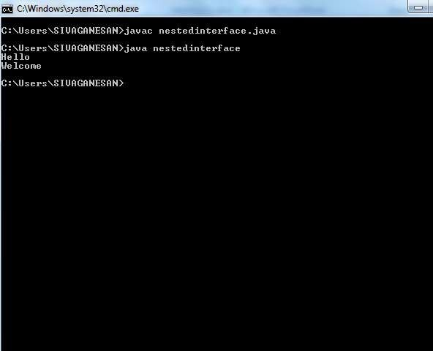
CS8392 Object Oriented Programming
Dr.D.Sivaganesan and N.Aravindhraj PSGiTech / CSE
13

Slide 14
Hybrid Inheritance
interface show
{ void draw(); } interface print
{ void msg(); }
class A { public void display()
{ System.out.println("base class");}} class B
{ void dis()
{System.out.println("B class");}}
class C extends A implements show
{ public void draw(){ System.out.println("Multiple inheritance");}} class D extends C implements print
{ void dis(){ System.out.println("D class");} public void msg()
{System.out.println("hybrid inheritance");}} class hybrid
{public static void main(String args[]){
C d=new C();d.display();d.draw();
D c = new D();c.dis();c.msg();}}
CS8392 Object Oriented Programming
Dr.D.Sivaganesan and N.Aravindhraj PSGiTech / CSE
14

Slide 15

CS8392 Object Oriented Programming
Dr.D.Sivaganesan and N.Arvindhraj PSGiTech / CSE
15

